Slide 1
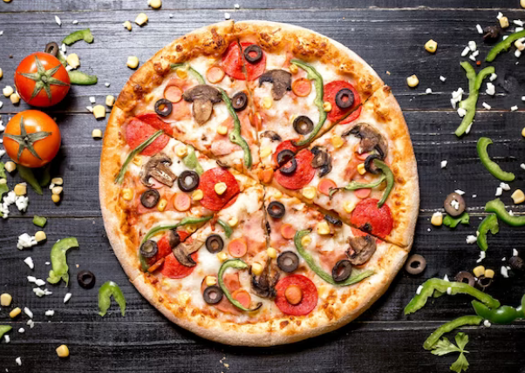
PIZZA SALES ANALYSIS (POWER BI)

Slide 2
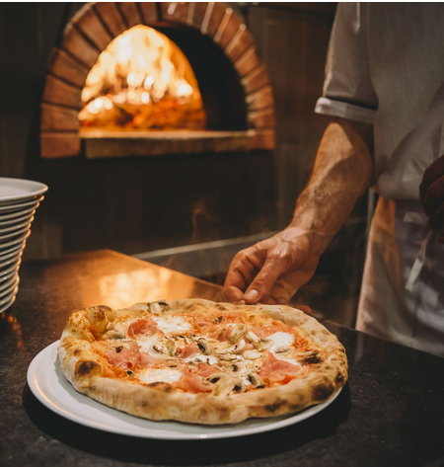
Problem Statement
Our pizza restaurant aims to leverage data analysis to optimize menu offerings, forecast demand, enhance marketing strategies, and improve operational efficiency.
By analyzing sales data, understanding customer preferences, and identifying trends, we seek to maximize profitability, streamline operations, and elevate the overall customer experience to maintain competitiveness in the food industry

Slide 3
Data Collection And Tools Used For Analysis
For our pizza sales analysis project, we sourced data from online platforms, compiling four CSV files: "order_details", "order", "pizzas", and "pizza_types".
The "order_details" and "order" CSV files encompass essential information regarding orders, including order details such as order IDs, timestamps. On the other hand, the "pizzas" and "pizza_types" CSV files contain comprehensive data about various pizza offerings, encompassing details such as pizza IDs, names, ingredients, and types.
To analyze this dataset effectively, we employed the Power BI tool, leveraging its robust capabilities for data visualization, exploration, and analysis. Utilizing Power BI, we aim to uncover actionable insights, identify sales trends, and optimize business strategies to enhance overall performance and profitability in the competitive pizza market.

Slide 4
Challenges Faced
Limited Customer Insight: Absence of demographic data hindered detailed customer segmentation analysis, limiting our understanding of sales patterns across different customer groups
Historical Data Limitation: Limited historical data availability restricted our ability to analyze long-term sales trends comprehensively.
Data Quality Issues: Another challenge stemmed from data quality issues within some columns. Inconsistent formatting, missing values, and inaccuracies in certain fields impeded the accuracy and reliability of our analysis. Cleaning and preprocessing the data to address these issues required considerable effort and time.

Slide 5
Objectives
Menu Optimization: Refine menu offerings based on sales trends and category analysis to maximize profitability and customer satisfaction.
Operational Efficiency: Utilize hourly sales data to optimize staffing and production schedules, ensuring efficient operations
Customer Engagement: Target marketing efforts and promotions based on weekly sales trends to drive traffic during off-peak periods.
Quarterly Growth Analysis: Assess business growth trends and allocate resources accordingly to sustain growth.
Sales Performance Enhancement: Implement strategies to boost sales of less popular items and capitalize on top-selling pizzas.
KPI Monitoring: Track key performance indicators to measure business performance and inform decision-making.

Slide 6
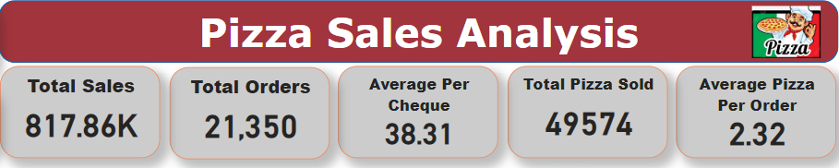
KEY PERFORMANCE INDICATORS
The total sales revenue of around $817K generated from 21,350 orders reflects a robust level of customer engagement. With an average order price of $38.31, it suggests that customers tend to make purchases with moderate to high-value transactions.
With an average of 2.32 pizzas sold per order, it suggests that customers often purchase multiple pizzas in a single transaction. This observation underscores the popularity and appeal of pizzas as a preferred choice among customers, potentially indicating a trend towards group dining or family-sized orders.
Recommendations:
Upselling Opportunities: Train staff to upsell and cross-sell additional pizzas or complementary items during the ordering process. Encourage suggestive selling techniques by highlighting popular pizza combinations, seasonal specials, or add-on options such as appetizers, desserts, or drinks.

Slide 7
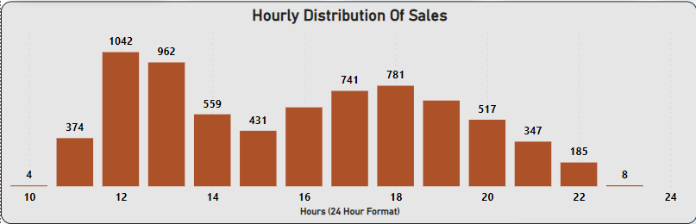
Daily Sales Peaks: Analysis of Hourly Distribution Trends
The hourly distribution of sales throughout the year, represented by a bar chart spanning from 10 AM to 12 AM reveals distinct patterns of activity.
Peak sales occur during the midday hours, particularly between 12 PM and 2 PM, indicating heightened customer engagement and transactional activity during lunchtime.
Following this peak period, there is a moderate level of sales activity observed from 4 PM to the 7 PM, corresponding to the late afternoon to early evening timeframe.
Recommendations:
Optimize Staffing: Allocate additional staff during peak hours
Menu Specials: Introduce happy hour deals during the moderate activity periods between 2 PM to 4 PM to attract customers and stimulate sales during quieter times of the day.

Slide 8
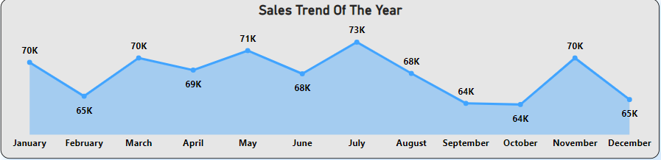
Analysis of Sales Growth Trends
The sales growth trend exhibits a distinctive zigzag pattern, fluctuating between 65k and 70k until August. However, post-August, a notable decline is observed in September and October, followed by a subsequent rise in November, maintaining the characteristic zigzag trajectory.
Possible Reasons:
No Monday Sales in October: This anomaly suggests a significant deviation from typical sales patterns and warrants further investigation into potential underlying factors impacting Monday sales performance
Decreased Pizza Sales in September and October: lower volume of pizzas sold during the months of September and October compared to other months. This may indicate seasonal fluctuations, shifts in consumer preferences, or external factors influencing demand.
Reduced Friday Sales During Dipping Phase: While Fridays typically exhibit higher sales volume consistently throughout the year, it's observed that during this dipping phase
Recommendations:
Seasonal Menu Offerings: Introduce seasonal menu items or promotions tailored to the changing preferences and demands of customers during the fall months.

Slide 9
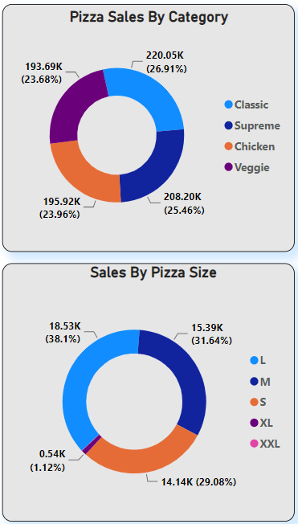
Category and Size Distribution Analysis
Pizza sales distribution reveals an even spread across four categories, with three offering non-vegetarian options (Classic, Supreme and Chicken) and one featuring vegetarian choices (Veggie). Small, medium, and large pizzas constitute 98% of total sales, whereas XL and XXL sizes comprise less than 2%.
Recommendations:
Educate customers on the benefits of larger pizzas for group dining
Gather customer feedback to refine offerings and enhance satisfaction
Reconsidering XXL Size Pizzas:Given their minimal contribution to total sales, it may be prudent to reassess the inclusion of XXL size pizzas on the menu

Slide 10
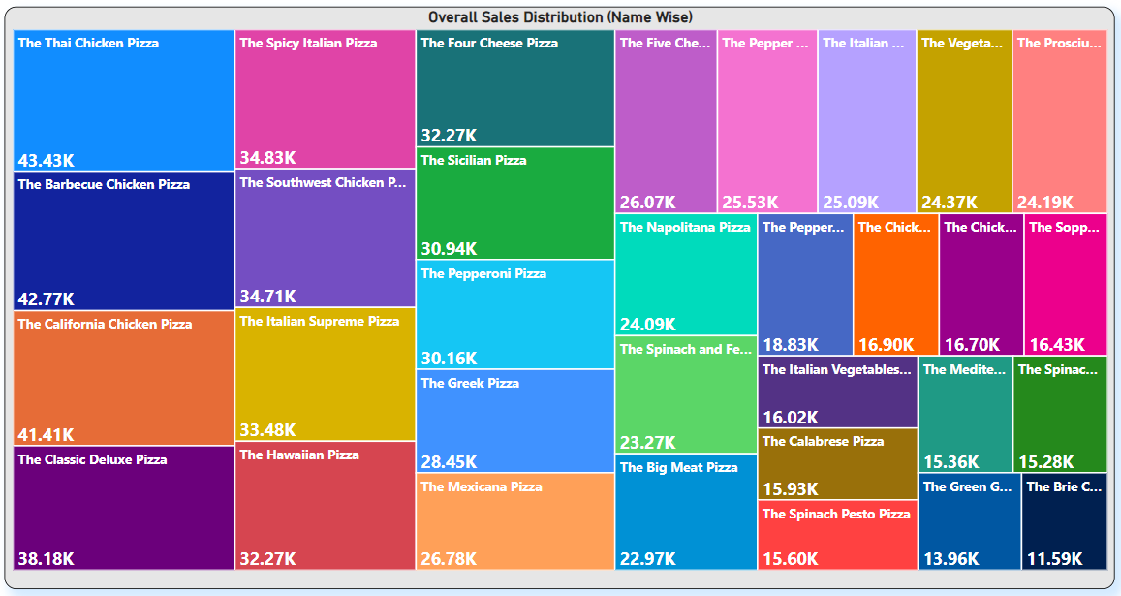
Exploring Pizza Popularity: A Tree Map Analysis
Dominant Pizzas: The tree map showcases the top-selling pizzas as prominent rectangles, indicating their dominance in the market.
Recommendations:
Targeted Marketing: Design targeted marketing campaigns that highlight popular pizzas to attract customers and drive sales

Slide 11
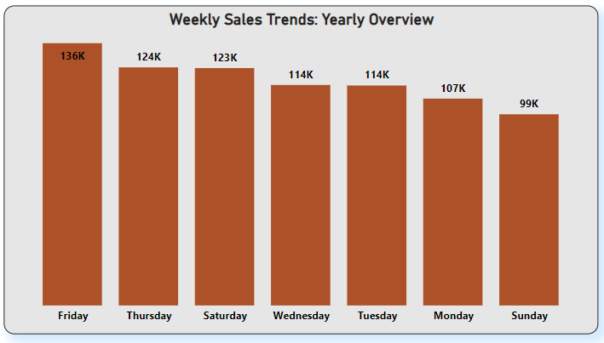
Exploring Weekly Sales Trends
Notably, Fridays emerge as the most engaging day. This trend aligns with consumer behavior, as Fridays often mark the end of the workweek, prompting individuals to indulge in convenient dining options like pizza.
The observation of heightened sales on Friday could also be attributed to the implementation of BOGO (Buy One Get One) promotions by pizza stores.
Sundays exhibit lower sales compared to other days of the week. This observation could be attributed to various factors, such as decreased consumer activity due to weekend relaxation, home-cooked meals, or preferences for other dining options.
Recommendations:
Menu Adjustments: Tailor the menu offerings to better align with consumer preferences on Sundays. Introduce lighter or healthier pizza options, brunch-inspired pizzas, or combo deals to appeal to customers.

Slide 12
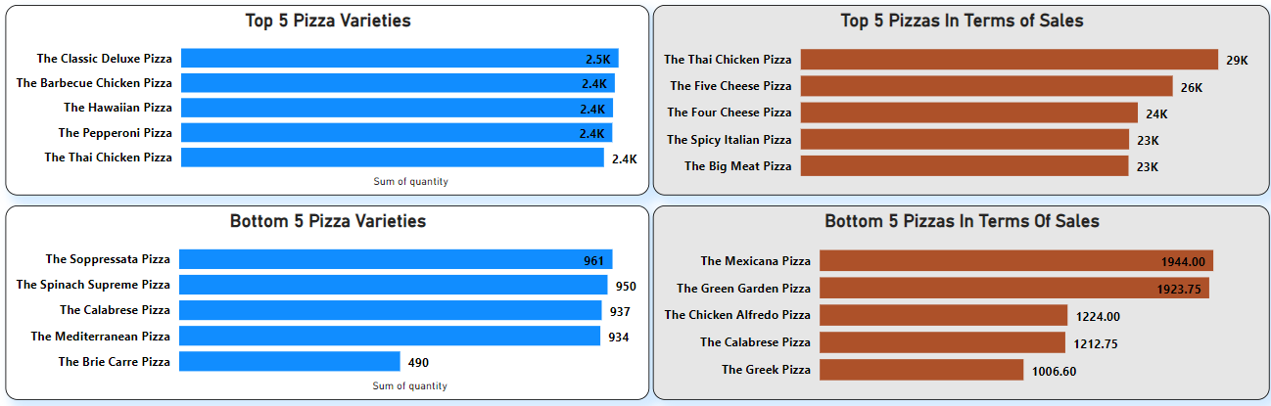
Pizza Sales Spotlight: Unveiling Top Hits and Underdogs
Our analysis uncovered a spectrum of performance among pizzas, with some emerging as consistent revenue generators while others struggled to make a significant impact. The top five pizzas, distinguished by their robust order frequency and impressive sales figures, stood out as pillars of profitability.
Conversely, the bottom five pizzas, despite their presence on the menu, failed to garner substantial orders or generate significant sales. Whether due to lack of appeal, pricing mismatch, or insufficient marketing efforts, these pizzas fell short of expectations and struggled to carve out a niche in the competitive landscape.

Slide 13
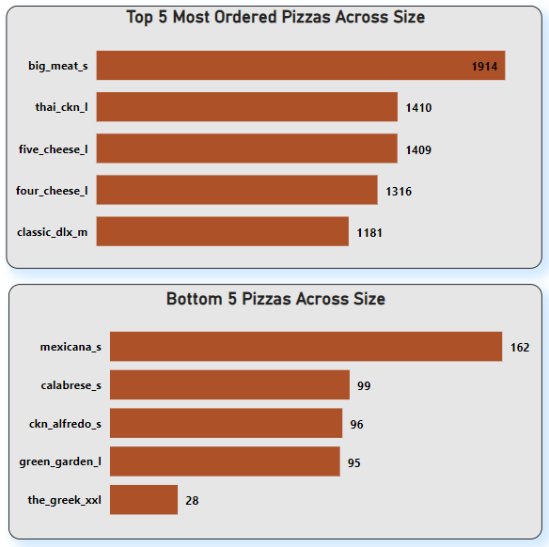
Pizza Sales Spotlight: Unveiling Top Hits and Underdogs
The top five pizzas, representing the pinnacle of popularity, consistently outshined others in terms of sales volume. These pizzas, perhaps owing to their classic appeal or innovative combinations, captured the taste buds and wallets of customers across the board.
On the contrary, the bottom five pizzas struggled to gain traction, facing challenges in resonating with the preferences of the target audience.
Recommendations:
Customer Feedback: Actively seek feedback from customers to understand their preferences and address any concerns or shortcomings in the bottom-selling pizzas. Incorporating customer input can guide menu adjustments and enhance overall satisfaction.

Slide 14
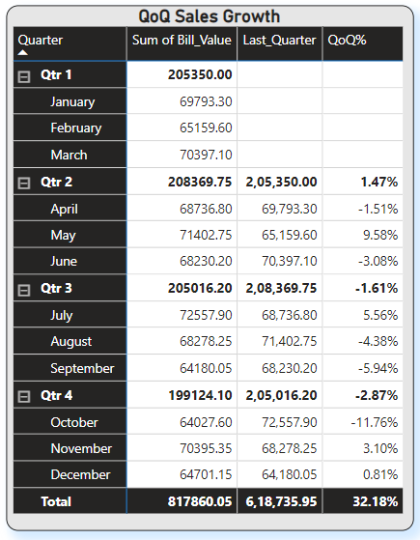
Navigating Quarterly Performance: Insights from Power BI Matrix Analysis
The matrix chart analysis unveils distinct patterns in quarterly growth rates. Quarter 2 demonstrates a modest yet positive growth of 1.47%, signaling a period of expansion and opportunity. However, this upward trend takes a downturn in quarters 3 and 4, with growth rates plummeting to -1.61% and -2.87% respectively.
Reasons:
In dissecting the sales data, several noteworthy trends emerge. Firstly, the absence of sales on Mondays during October indicates a peculiar anomaly that warrants investigation.
The dip in pizza sales volumes observed in September and October. Notably, this downward trend coincides with the transitional period between the third and fourth quarters, exerting a compounding effect on both quarters' performance.
Furthermore, the deviation from the typical pattern of Fridays being the busiest day of the week during this period underscores the disruptive nature of seasonal variations on consumer engagement.

Slide 15
Conclusion
In summary, our analysis of pizza sales data reveals a robust level of customer engagement, with total sales revenue reaching approximately $817K from 21,350 orders. Peak sales occur during midday hours, particularly between 12 PM and 2 PM, though quarterly growth rates show a decline in quarters 3 and 4, notably in September and October.
Several factors contribute to this decline, including anomalies like the absence of Monday sales in October and reduced sales volume during September and October. Understanding these trends is crucial for strategic decision-making and intervention.
Furthermore, our analysis highlights varying performance among pizza categories, with the top five consistently outperforming others. Recommendations include adapting menu offerings and implementing promotional strategies to mitigate seasonal fluctuations and drive sustained growth.
By leveraging these insights, businesses can optimize strategies and enhance overall performance in the competitive pizza market.

